Slide 1
GDP Forecast
Nikhil Gupta
Stuart Miller

Slide 2
Motivation
We would like to forecast downturns in GDP.
Two consecutive quarters of decline in GDP is considered a working definition of a recession.*
We will forecast two steps ahead to see if models can capture these declines.
*investopedia.com/terms/r/recession.asp

Slide 3
Dataset
Response Variable: % change in GDP (USA)
Quarterly observations from 1971 to 2019
195 observations
An additional 13 exogenous variables were also collected.
Data was collected from the Federal Reserve Bank of St. Louis Economic Data (FRED)
https://fred.stlouisfed.org/

Slide 4
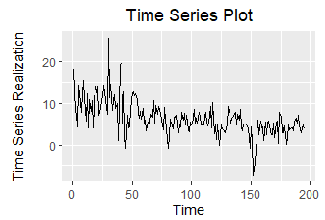
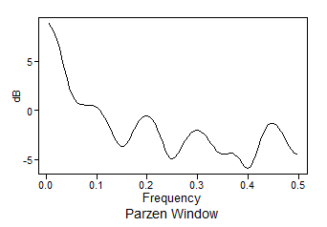
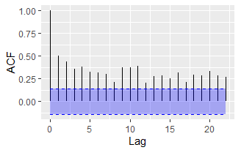
Stationarity of the Series
Assess Assumption of Constant Mean
There appears to be a slight trend in the realization.
The spectral density shows a high peak at 0, which could be generated by a stationary or non-stationary process.
The ACF shows a hint of extended autocorrelations, which could indicate a non-stationary process.
Since the mean appears to change over time, this suggests a non-stationary process.

Slide 5
Stationarity of the Series
Assess Assumption of Constant Variance
Since only one realization is possible, it is difficult to assess the realization variance.
However, there is more volatility in the first half (before 75) than in the second half.
This may be an indication of non-constant variance, which would suggest a non-stationary process.

Slide 6
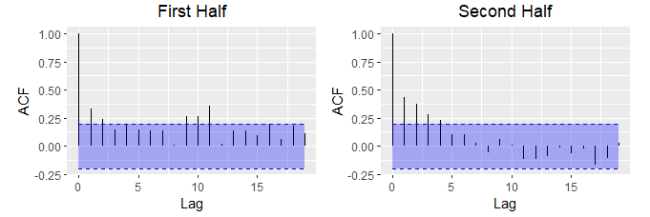
Stationarity of the Series
Assess Assumption of Constant Autocorrelation
The ACFs of the first and second half exhibit different characteristics.
Little exponentially damped autocorrelations and hint of seasonality in first half
More exponentially damped autocorrelations and no hints of seasonality in the second half.
This may suggest a non-stationary process.

Slide 7
Stationarity of the Series
Based on the analysis, there appears to be evidence that the process is non-stationary
However, we expect that the change in GDP will eventually stabilize to a stationary process in the long run. If so, it may be possible to model this as a stationary process in the long run.
We will continue the analysis modeling the data with ARMA and ARIMA.

Slide 8
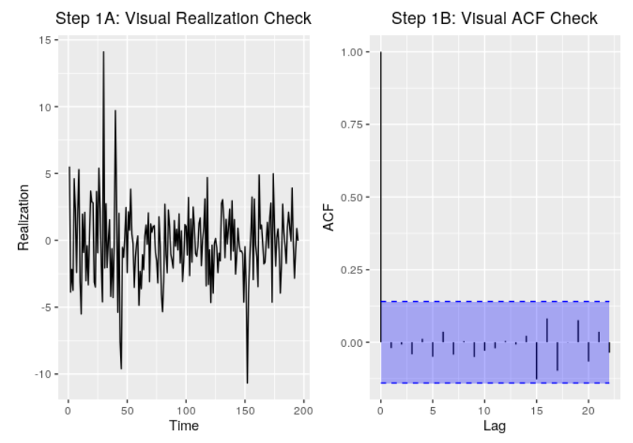
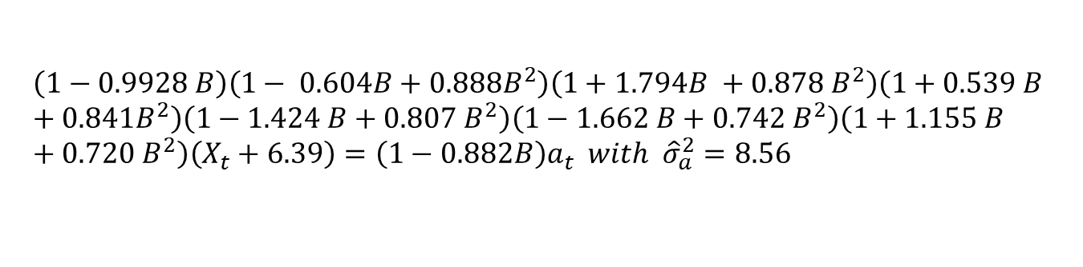
ARMA Modeling
Model ID with AIC suggests an ARMA(13, 1) order model.
The ARMA(13, 1) fit with maximum likelihood produces a root close to the unit circle
Factored Model
Plots of Residuals Fit Scores
$$\left(1−0.9928 B\right)\left(1− 0.604B+0.888B^{2}\right)\left(1+1.794B +0.878 B^{2}\right)\left(1+0.539 B +0.841B^{2}\right)\left(1−1.424 B+0.807 B^{2}\right)\left(1−1.662 B+0.742 B^{2}\right)\left(1+1.155 B+0.720 B^{2}\right)\left(X_{t}+6.39\right)=\left(1−0.882B\right)a_{t} with {\hat{σ}}_{a}^{2}=8.56$$

Slide 9
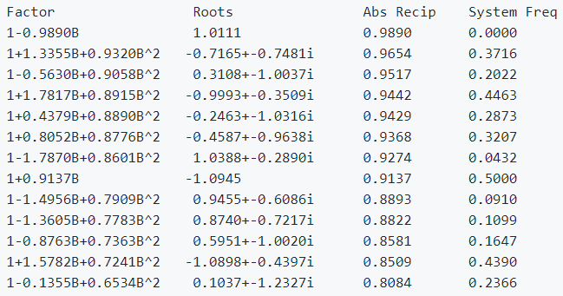
ARIMA Model: Model ID (Overfit Table)
An overfit table was fit to the series with p = 24 (change to 15).
There is no indication of seasonal behavior.
The root at 1.0111 may be evidence of unit root.

Slide 10
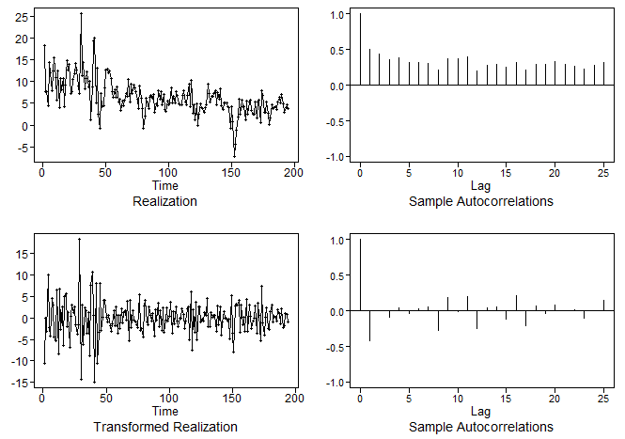
ARIMA Modeling
After taking the first difference we see
The change in mean appears to have been removed.
The autocorrelations are significantly reduced and appear to fall off at a higher rate.

Slide 11
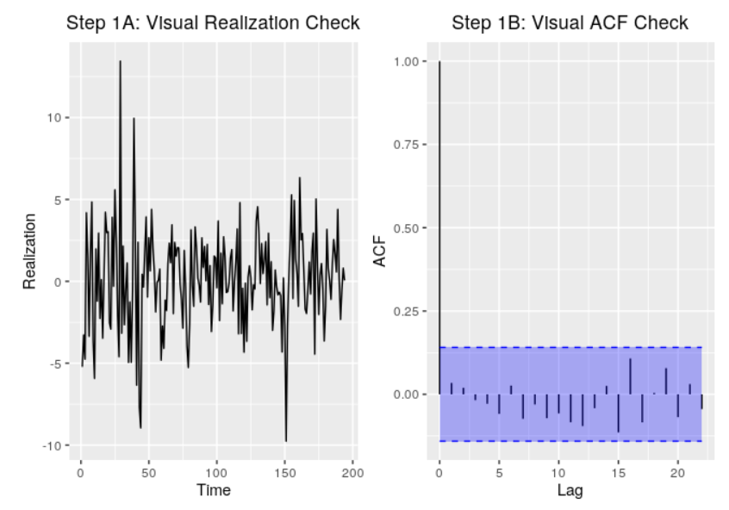
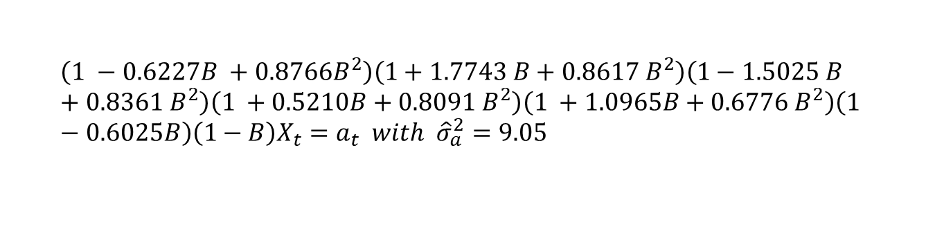
ARIMA Modeling
Model ID by AIC suggests an ARMA(12, 1) and BIC suggests an AR(11)
We will choose to fit the smaller model.
Factored Model
Plots of Residuals Fit Scores
$$\left(1 −0.6227B +0.8766B^{2}\right)\left(1+1.7743 B+0.8617 B^{2}\right)\left(1−1.5025 B+0.8361 B^{2}\right)\left(1 +0.5210B+0.8091 B^{2}\right)\left(1 +1.0965B+0.6776 B^{2}\right)\left(1 −0.6025B\right)\left(1−B\right)X_{t}=a_{t} with {\hat{σ}}_{a}^{2}=9.05$$

Slide 12
Forecast Performance
Each model was validated with a sliding window forecast
Window size of 50 (12 years)
Forecast on 2 steps ahead
Results in 73 ASE calculation
The results of the forecast validation are shown below
The mean and median ASE are similar
The SD of the ASEs is large
No indication that either model is better

Slide 13
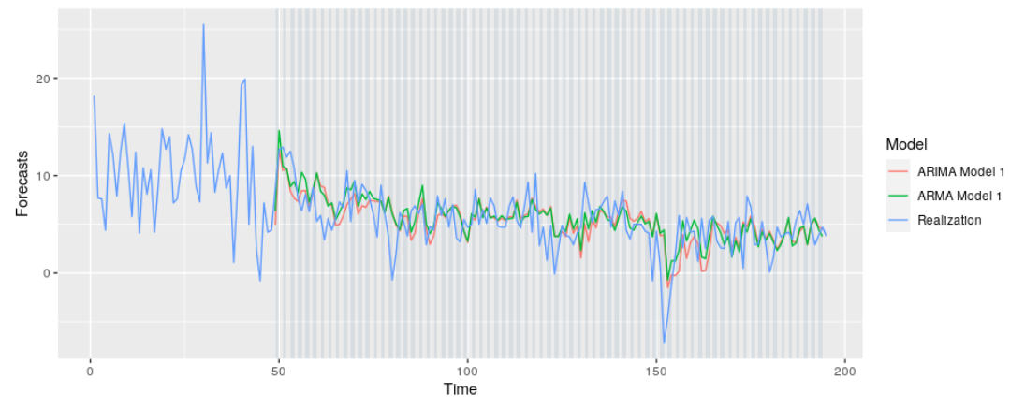
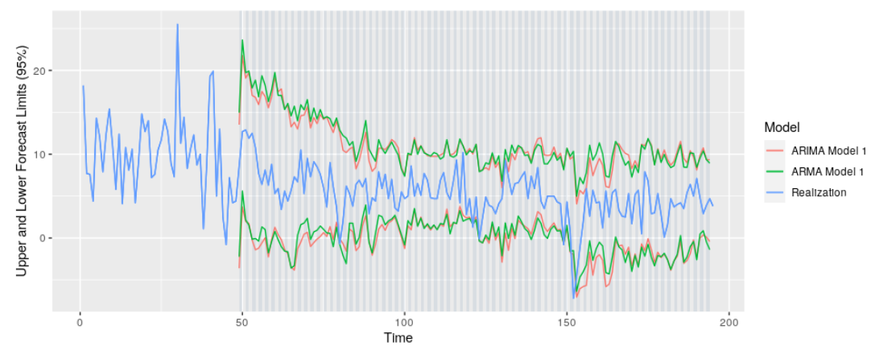
Forecast Performance
Visually, the models appear to produce similar forecasts.

Slide 14
Next Steps
Univariate forecasting appears to perform poorly.
We expect that inclusion of exogenous variable is necessary to improve forecast performance.
We have collected 13 exogenous variables that may provide useful information for modeling.

Slide 15
More Information
Git Repo:
https://github.com/ngupta23/gdp_prediction
Youtube Video:

Slide 16
References
Jim Chappelow, Recession, Investopedia. Accessed March 6, 2020. https://www.investopedia.com/terms/r/recession.asp
U.S. Bureau of Economic Analysis, Gross Domestic Product [A191RP1Q027SBEA], retrieved from FRED, Federal Reserve Bank of St. Louis; https://fred.stlouisfed.org/series/A191RP1Q027SBEA, March 6, 2020.
U.S. Bureau of Labor Statistics, All Employees, Total Nonfarm [PAYEMS], retrieved from FRED, Federal Reserve Bank of St. Louis; https://fred.stlouisfed.org/series/PAYEMS, March 6, 2020.
Board of Governors of the Federal Reserve System (US), 10-Year Treasury Constant Maturity Rate [DGS10], retrieved from FRED, Federal Reserve Bank of St. Louis; https://fred.stlouisfed.org/series/DGS10, March 6, 2020.
Board of Governors of the Federal Reserve System (US), Effective Federal Funds Rate [FEDFUNDS], retrieved from FRED, Federal Reserve Bank of St. Louis; https://fred.stlouisfed.org/series/FEDFUNDS, March 6, 2020.
U.S. Bureau of Economic Analysis, Real Disposable Personal Income [A067RO1Q156NBEA], retrieved from FRED, Federal Reserve Bank of St. Louis; https://fred.stlouisfed.org/series/A067RO1Q156NBEA, March 6, 2020.
U.S. Bureau of Labor Statistics, Consumer Price Index for All Urban Consumers: All Items in U.S. City Average [CPIAUCNS], retrieved from FRED, Federal Reserve Bank of St. Louis; https://fred.stlouisfed.org/series/CPIAUCNS, March 6, 2020.
U.S. Bureau of Economic Analysis, Population [POPTHM], retrieved from FRED, Federal Reserve Bank of St. Louis; https://fred.stlouisfed.org/series/POPTHM, March 6, 2020.
U.S. Bureau of Economic Analysis, Corporate Profits After Tax (without IVA and CCAdj) [CP], retrieved from FRED, Federal Reserve Bank of St. Louis; https://fred.stlouisfed.org/series/CP, March 6, 2020.
Federal Reserve Bank of St. Louis, Spot Crude Oil Price: West Texas Intermediate (WTI) [WTISPLC], retrieved from FRED, Federal Reserve Bank of St. Louis; https://fred.stlouisfed.org/series/WTISPLC, March 6, 2020.
ICE Benchmark Administration Limited (IBA), Gold Fixing Price 10:30 A.M. (London time) in London Bullion Market, based in U.S. Dollars [GOLDAMGBD228NLBM], retrieved from FRED, Federal Reserve Bank of St. Louis; https://fred.stlouisfed.org/series/GOLDAMGBD228NLBM, March 6, 2020.
Board of Governors of the Federal Reserve System (US), Japan / U.S. Foreign Exchange Rate [EXJPUS], retrieved from FRED, Federal Reserve Bank of St. Louis; https://fred.stlouisfed.org/series/EXJPUS, March 6, 2020.
Board of Governors of the Federal Reserve System (US), U.S. / U.K. Foreign Exchange Rate [EXUSUK], retrieved from FRED, Federal Reserve Bank of St. Louis; https://fred.stlouisfed.org/series/EXUSUK, March 6, 2020.

